Slide 1


Fábio Rodrigo C da Silva
March 9, 2024

Slide 2

Outline
Executive Summary
Introduction
Methodology
Results
Conclusion
Appendix

Slide 3
Executive Summary
Objective: predict if the Falcon 9 first stage will land successfully.
Because SpaceX can reuse the first stage during launch, it’s possible to save millions of dollars. So, this project intends to predict if the first stage will land successfully and, with that information, determine the cost of a launch. This prediction is based on data from previous launch.
The data was collected using the SpaceX API. After cleaned, it was performed an exploratory data analysis using graphs and SQL queries. A visual analytics system was created to better understanding the relation between variables.
At the final step, four machine learning classification models were used to predict the outcome of launches. The decision tree model was the best, and performed with an accuracy of 86% on training data, and 83% on test data.

Slide 4
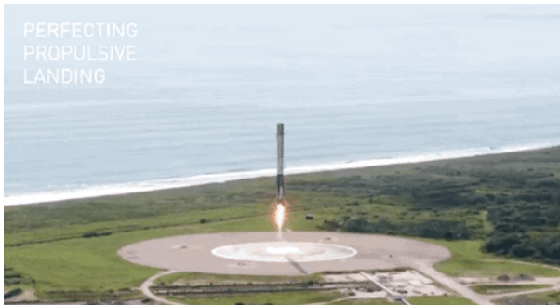
GitHub
https://github.com/fabiorodrigocs/IBMCapstone

Slide 5

Section 1

Slide 6
Methodology
Executive Summary
Data collection methodology:
Perform data wrangling
Perform exploratory data analysis (EDA) using visualization and SQL
Perform interactive visual analytics using Folium and Plotly Dash
Perform predictive analysis using classification models

Slide 7
Data Collection
The data were collected from the SpaceX API, and cleaned the requested data to make sure it was in the correct format.
So, it resulted in a Pandas data frame that contains the dataset.
It was performed through web scraping to collect Falcon 9 historical launch records from a Wikipedia page titled List of Falcon 9 and Falcon Heavy Launches.
It was performed Exploratory Data Analysis (EDA) to find patterns in the data and determine what would be the label for training supervised models.

Slide 8
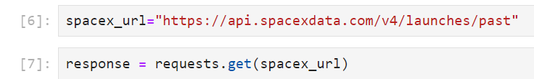
Data Collection – SpaceX API
Present your data collection with SpaceX REST calls using key phrases and flowcharts
1) Import libraries and auxiliary functions
2) Now let's start requesting rocket launch data from SpaceX API with the following URL
3) Request and parse the SpacX launch data using the GET request
4) Filter the dataframe to only include Falcon 9 launches
Link: https://github.com/fabiorodrigocs/IBMCapstone/blob/10b29ca34c976d29672521c0a6b5b6dcd727df5c/W1%20-%201%20-%20jupyter-labs-spacex-data-collection-api.ipynb

Slide 9
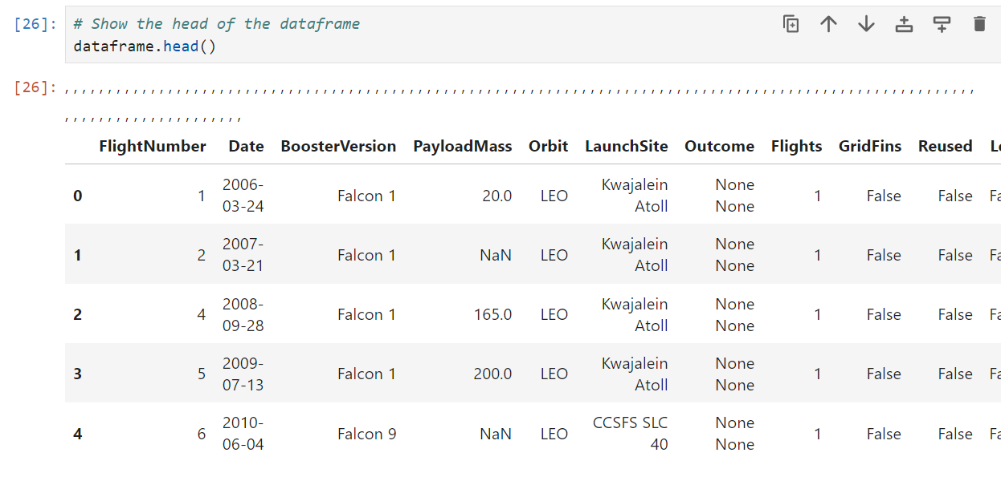
Data Collection – SpaceX API
Pandas dataframe after dealing with missing values.
Link:
https://github.com/fabiorodrigocs/IBMCapstone/blob/10b29ca34c976d29672521c0a6b5b6dcd727df5c/W1%20-%201%20-%20jupyter-labs-spacex-data-collection-api.ipynb

Slide 10
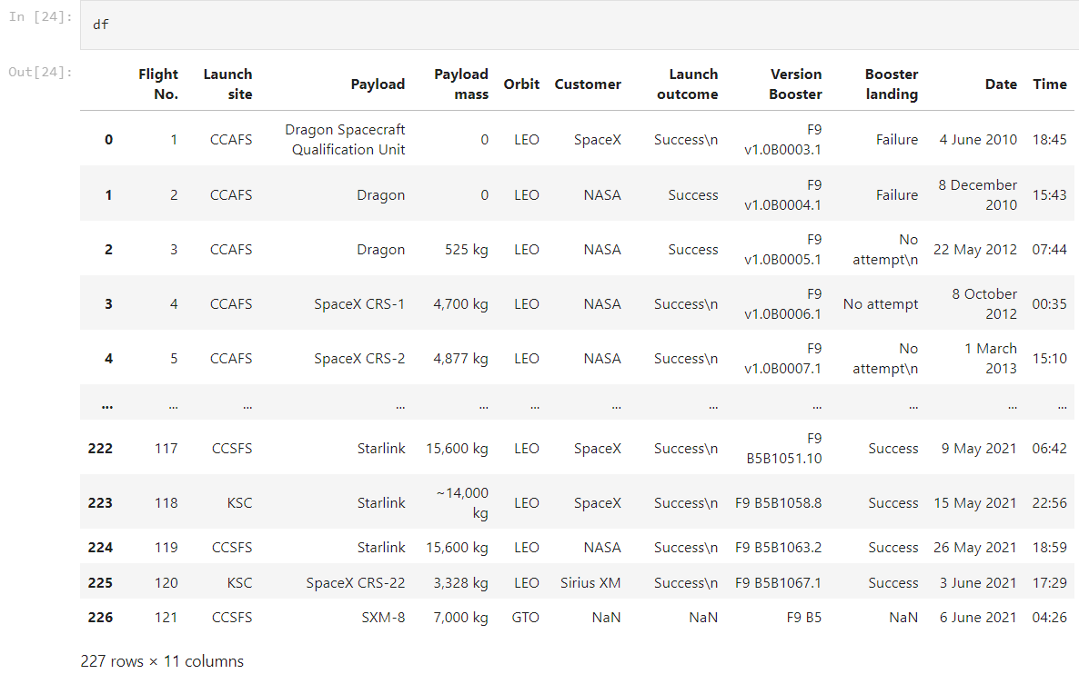
Data Collection - Scraping
Web scrap Falcon 9 launch records with BeautifulSoup:
1) Extract a Falcon 9 launch records HTML table from Wikipedia
2) Parse the table and convert it into a Pandas data frame
Link:
https://github.com/fabiorodrigocs/IBMCapstone/blob/10b29ca34c976d29672521c0a6b5b6dcd727df5c/W1%20-%202%20-%20jupyter-labs-webscraping.ipynb

Slide 11
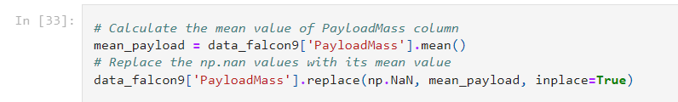
Data Wrangling
Some of the rows are missing values in our dataset, specially in PayloadMass column.
The LandingPad column retained None values to represent when landing pads were not used.
It was calculated the mean for the PayloadMass using the .mean().
Then It was used the mean and the .replace() function to replace np.nan values in the data with the mean calculated.
Link:
https://github.com/fabiorodrigocs/IBMCapstone/blob/10b29ca34c976d29672521c0a6b5b6dcd727df5c/W1%20-%201%20-%20jupyter-labs-spacex-data-collection-api.ipynb

Slide 12
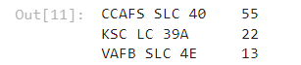
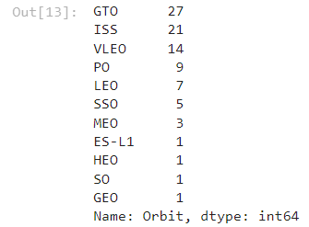
Data Wrangling
1): Calculated the number of launches on each site.
2) Calculated the number and occurrence of each orbit.
Link:
https://github.com/fabiorodrigocs/IBMCapstone/blob/10b29ca34c976d29672521c0a6b5b6dcd727df5c/W1%20-%201%20-%20jupyter-labs-spacex-data-collection-api.ipynb

Slide 13
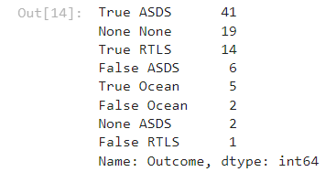
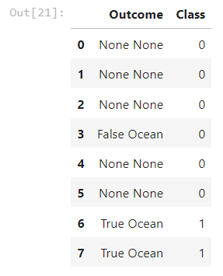
Data Wrangling
3) Calculated the number and occurence of mission outcome of the orbits.
4): Created a landing outcome label from Outcome column
Link:
https://github.com/fabiorodrigocs/IBMCapstone/blob/10b29ca34c976d29672521c0a6b5b6dcd727df5c/W1%20-%201%20-%20jupyter-labs-spacex-data-collection-api.ipynb

Slide 14
EDA with Data Visualization
Graphics used:
Scatter plot: used to visualize the relationship between numerical variables and to check whether there is a correlation between them or identify patterns of points on the graph.
Bar plot: represents the distribution of a categorical variable through bars. Each bar represents a specific category, and the height of the bar indicates the frequency or proportion of that category. The bar plot is useful for comparing the frequency or proportion between different categories and identifying patterns.
Link:
https://github.com/fabiorodrigocs/IBMCapstone/blob/10b29ca34c976d29672521c0a6b5b6dcd727df5c/W2%20-%202%20-%20jupyter-labs-eda-dataviz.ipynb.jupyterlite.ipynb

Slide 15
EDA with SQL
Display the names of the unique launch sites in the space mission
%sql SELECT DISTINCT "LauncH_Site" FROM SPACEXTABLE;
Display 5 records where launch sites begin with the string 'CCA'
%sql SELECT * FROM SPACEXTABLE WHERE Launch_Site LIKE 'CCA%' LIMIT 4;
%sql SELECT DISTINCT "Landing_Outcome" FROM SPACEXTABLE;
Display the total payload mass carried by boosters launched by NASA (CRS)¶
%sql SELECT SUM(PAYLOAD_MASS__KG_) FROM SPACEXTABLE WHERE "Customer" = 'NASA (CRS)’;
Display the total payload mass carried by boosters launched by NASA (CRS)¶
%sql SELECT AVG(PAYLOAD_MASS__KG_) FROM SPACEXTABLE WHERE Booster_Version LIKE 'F9 v1.1%’;
List the date when the first succesful landing outcome in ground pad was acheived.
%sql SELECT MIN(Date) FROM SPACEXTABLE WHERE "Mission_Outcome" = 'Success’;
Link:
https://github.com/fabiorodrigocs/IBMCapstone/blob/10b29ca34c976d29672521c0a6b5b6dcd727df5c/W2%20-%201%20-%20jupyter-labs-eda-sql-coursera_sqllite.ipynb

Slide 16
EDA with SQL
List the names of the boosters which have success in drone ship and have payload mass greater than 4000 but less than 6000
%sql SELECT "Booster_Version" FROM SPACEXTABLE WHERE "Mission_Outcome" = 'Success' AND PAYLOAD_MASS__KG_ > 4000 AND PAYLOAD_MASS__KG_ < 6000;
List the total number of successful and failure mission outcomes
%sql SELECT DISTINCT "Mission_Outcome" FROM SPACEXTABLE;
%sql SELECT COUNT(*) AS Success_Count, (SELECT COUNT(*) FROM SPACEXTABLE WHERE Mission_Outcome NOT LIKE 'Success%') AS Not_Success_Count FROM SPACEXTABLE WHERE Mission_Outcome LIKE 'Success%’;
List the names of the booster_versions which have carried the maximum payload mass. Use a subquery
%sql SELECT "Booster_Version" FROM SPACEXTABLE WHERE PAYLOAD_MASS__KG_ = (SELECT MAX(PAYLOAD_MASS__KG_) FROM SPACEXTABLE);
Link:
https://github.com/fabiorodrigocs/IBMCapstone/blob/10b29ca34c976d29672521c0a6b5b6dcd727df5c/W2%20-%201%20-%20jupyter-labs-eda-sql-coursera_sqllite.ipynb

Slide 17
EDA with SQL
List the records which will display the month names, failure landing_outcomes in drone ship ,booster versions, launch_site for the months in year 2015
%sql SELECT SUBSTR(Date, 6, 2) AS Month, "Booster_Version", "Launch_Site" FROM SPACEXTABLE WHERE SUBSTR(Date, 0, 5) = '2015' AND "Landing_Outcome" = 'Failure (drone ship)’;
Rank the count of landing outcomes (such as Failure (drone ship) or Success (ground pad)) between the date 2010-06-04 and 2017-03-20, in descending order.
%sql SELECT Landing_Outcome, COUNT(*) AS Count FROM SPACEXTABLE WHERE Date BETWEEN '2010-06-04' AND '2017-03-20' GROUP BY Landing_Outcome ORDER BY Count DESC;
Link:
https://github.com/fabiorodrigocs/IBMCapstone/blob/10b29ca34c976d29672521c0a6b5b6dcd727df5c/W2%20-%201%20-%20jupyter-labs-eda-sql-coursera_sqllite.ipynb

Slide 18
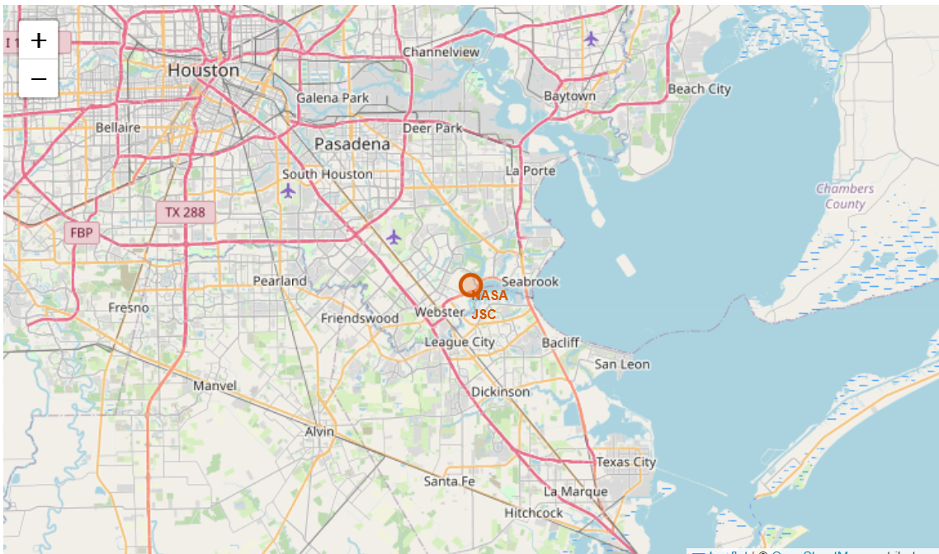
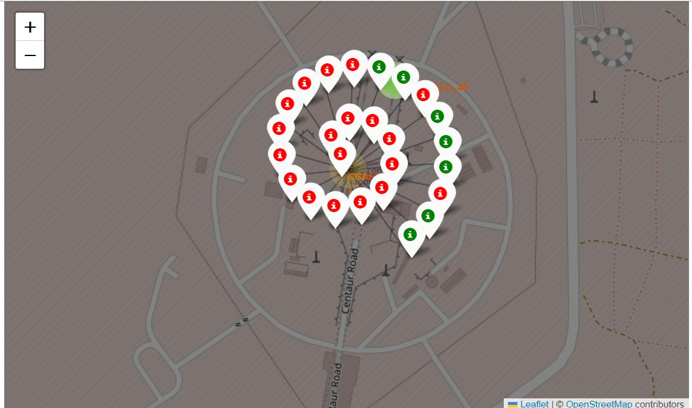
Build an Interactive Map with Folium
It was marked all launch sites on a map.
It was used folium.Circle to add a highlighted circle area with a text label on a specific coordinate.
It was created a red circle at NASA Johnson Space Center's coordinate with a popup label showing its name.
For each launch result in spacex_df data frame, It was added a folium.Marker to marker_cluster.
It was created a `folium.PolyLine` object using the coastline coordinates and launch site coordinate.
Link:
https://github.com/fabiorodrigocs/IBMCapstone/blob/709ccfcfa4077e8da37fd6663a3fe171a1eafa5d/W3-1%20lab_jupyter_launch_site_location.jupyterlite.ipynb

Slide 19
Build a Dashboard with Plotly Dash
The dashboard contains components such as:
a dropdown list
a range slider
a pie chart
a scatter point chart
It was added a Launch Site Drop-down Input Component and a a callback function to render success-pie-chart based on selected site dropdown.
Besides, It was added a Range Slider to Select Payload and a callback function to render the success-payload-scatter-chart scatter plot

Slide 20
Predictive Analysis (Classification)
It was created a machine learning pipeline to predict if the first stage will land given the data from the preceding labs.
1 – It was created a NumPy array from the column Class in data (variable Y)
2 – It was standardized the data in X
3 – It was used train_test_split to split the data X and Y into training (80%) and test (20%) data.
4 – It was created a Machine Learning object and a Grid Search to its parameters
5 – It was fitted the object with train data to find the best parameters
6 – It was calculated the accuracy on the test data
7 – It was evalueted the confusion matrix
The Machine Models used were:
Logistic Regression
SVC (Support Vector Machine)
Decidion Tree Classifier
KNN (k-nearest neighbors)
Link:
https://github.com/fabiorodrigocs/IBMCapstone/blob/8e13fa89cc9baa3a954b574fac4906e1c4684ef4/W4%20-%20SpaceX_Machine_Learning_Prediction_Part_5.jupyterlite%20B.ipynb

Slide 21
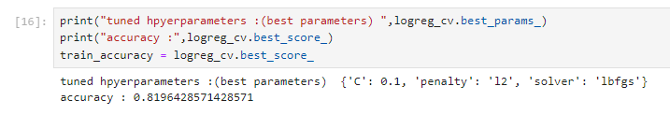
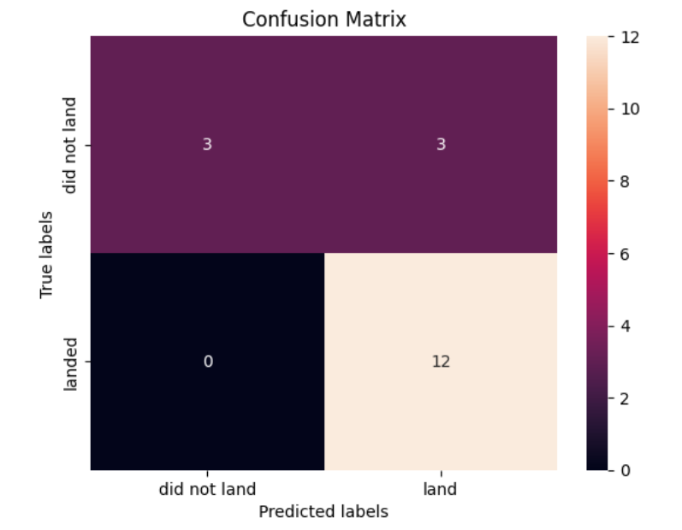
Results
Logistic Regression
Link:
https://github.com/fabiorodrigocs/IBMCapstone/blob/8e13fa89cc9baa3a954b574fac4906e1c4684ef4/W4%20-%20SpaceX_Machine_Learning_Prediction_Part_5.jupyterlite%20B.ipynb

Slide 22
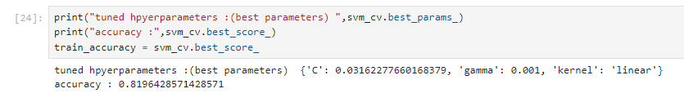
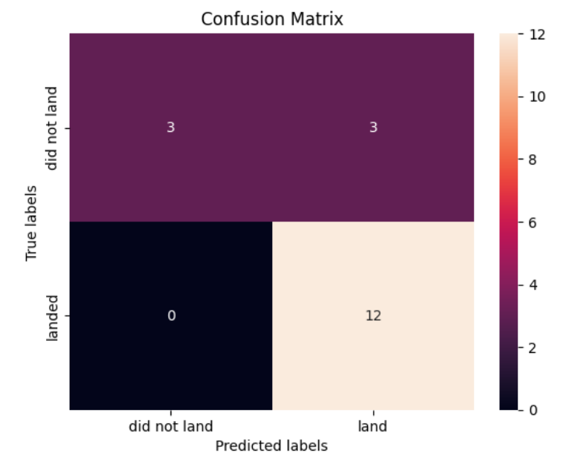
Results
SVC (Support Vector Machine)
Link:
https://github.com/fabiorodrigocs/IBMCapstone/blob/8e13fa89cc9baa3a954b574fac4906e1c4684ef4/W4%20-%20SpaceX_Machine_Learning_Prediction_Part_5.jupyterlite%20B.ipynb

Slide 23
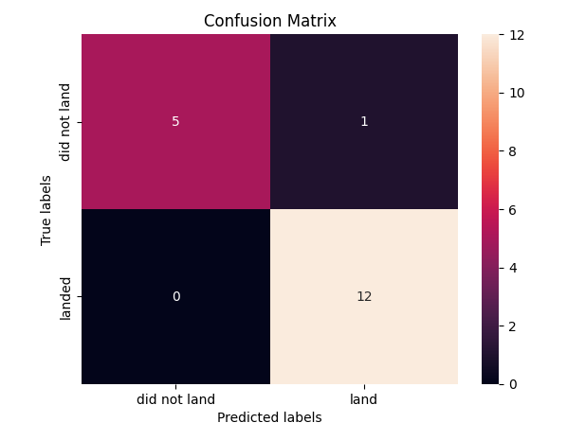
Results
Decision Tree Classifier
Link:
https://github.com/fabiorodrigocs/IBMCapstone/blob/8e13fa89cc9baa3a954b574fac4906e1c4684ef4/W4%20-%20SpaceX_Machine_Learning_Prediction_Part_5.jupyterlite%20B.ipynb

Slide 24
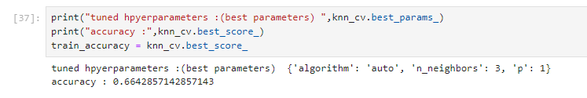
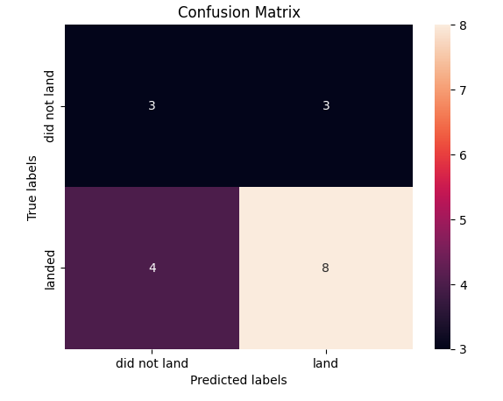
Results
KNN (k-nearest neighbors)
Link:
https://github.com/fabiorodrigocs/IBMCapstone/blob/8e13fa89cc9baa3a954b574fac4906e1c4684ef4/W4%20-%20SpaceX_Machine_Learning_Prediction_Part_5.jupyterlite%20B.ipynb

Slide 25

Section 2

Slide 26
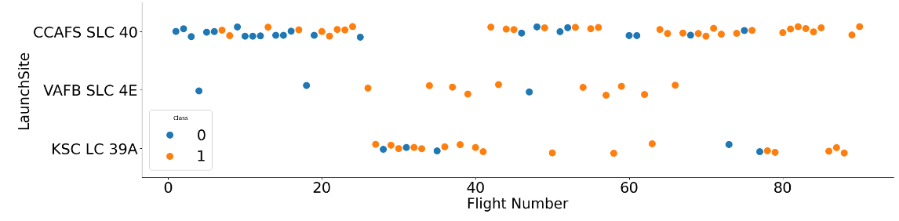
Flight Number vs. Launch Site
As can be seen in the graph, launches on the VAFB SLC 4E website were more successful.
Furthermore, as the number of launches increases, the number of successes increases. This can be clearly observed in CCAFS SLC 40, where the first launches resulted in failure and the last ones in success.

Slide 27
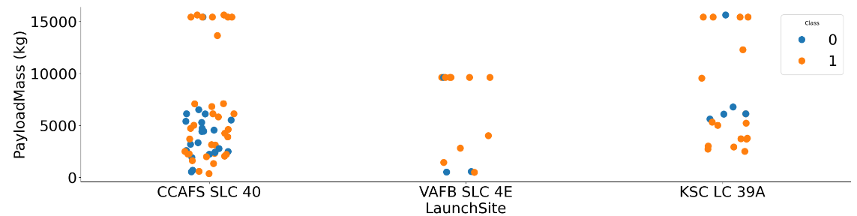
Payload vs. Launch Site
As can be seen in the graph, the largest number of launches occurred on the CCFAS SLC 40 site.
A higher payload mass indicates that the chance of success is greater.
VABF launchsite had the lowest number of launches.

Slide 28
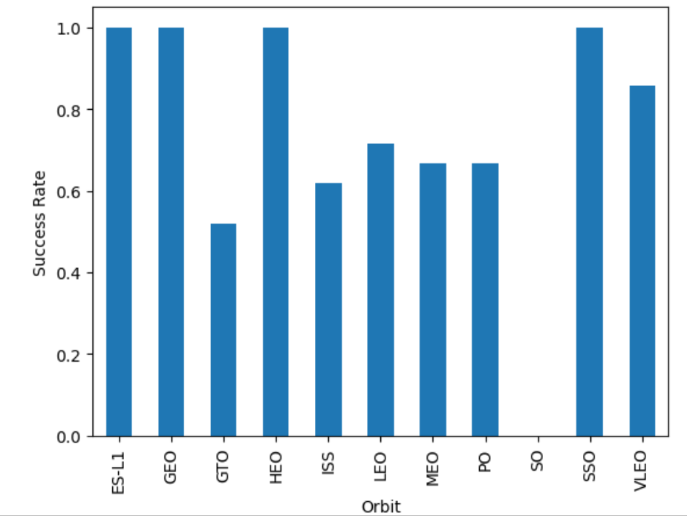
Success Rate vs. Orbit Type
As can be seen in the graph, a high success rate was achieved for the ES-L1, GEO, HEO and SSO orbits.
The FTO and ISS orbits had a lower success rate.

Slide 29
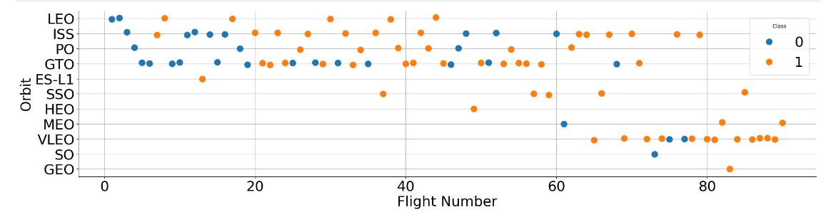
Flight Number vs. Orbit Type
As can be seen in the graph, most launches occur in GTO, PO, ISS and LEO orbits.
There is a tendency for failure in the first launches of each orbit
As the number of flights increases, successful launches increase.

Slide 30
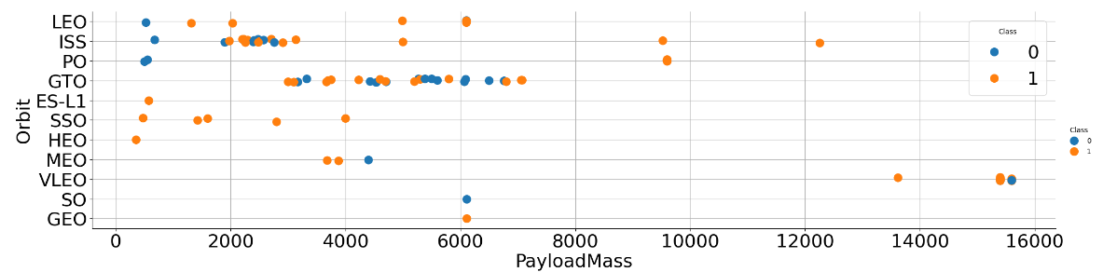
Payload vs. Orbit Type
As can be seen in the graph, most loads are up to 8000 kg
From this graph, it cannot be concluded that there is a correlation between Payloadmass and launch success
The VLEO orbit concentrated the highest Payloadmass values

Slide 31
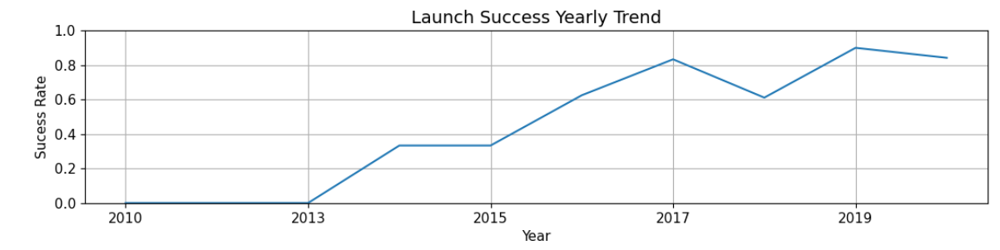
Launch Success Yearly Trend
As can be seen in the graph, the annual success rate clearly increases over the years, reflecting a learning curve in launches.

Slide 32
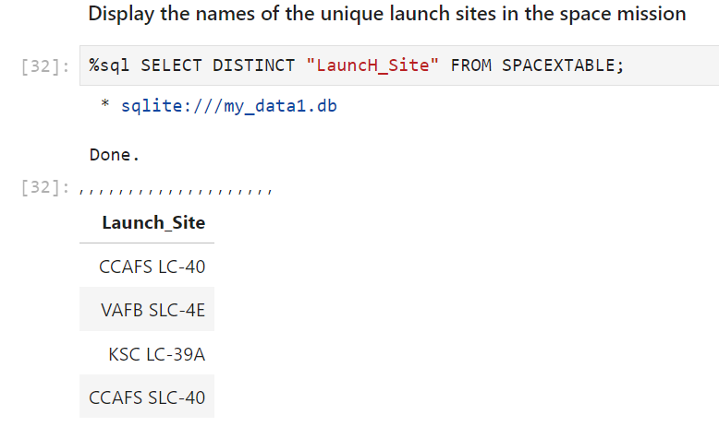
All Launch Site Names
The names of all launch sites was obtained using a SELECT DISTINCT query.

Slide 33
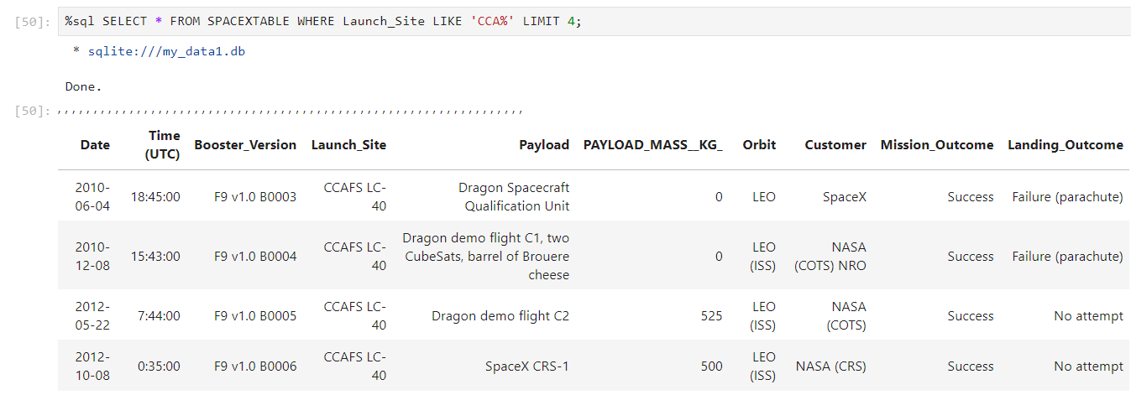
Launch Site Names Begin with 'CCA'
The 5 records where launch sites begin with `CCA` were obtained using a SELECT query plus a LIMIT keyword.

Slide 34
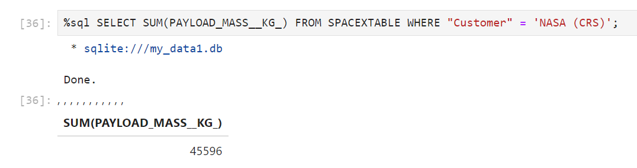
Total Payload Mass
The total payload carried by boosters from NASA was obtained using a SELECT query plus the SUM() function.

Slide 35
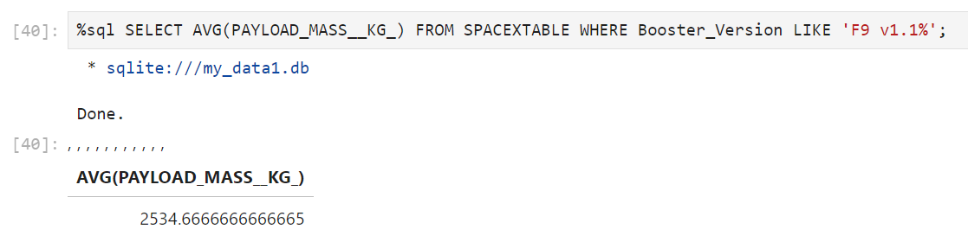
Average Payload Mass by F9 v1.1
The average payload mass carried by booster version F9 v1.1 was obtained using a SELECT query plus a AVG() funcition and a LIKE keyword.

Slide 36
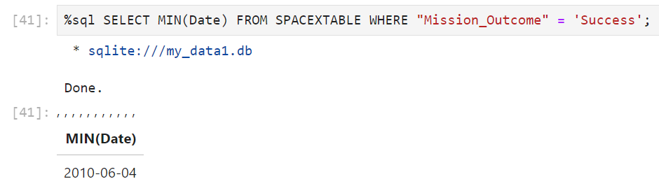
First Successful Ground Landing Date
The date of the first successful landing outcome on ground pad was obtained using a SELECT query plus a MIN(Date) function and WHERE.

Slide 37
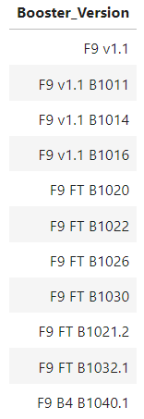
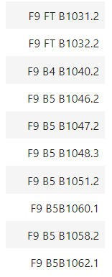
Successful Drone Ship Landing with Payload between 4000 and 6000
The names of boosters which have successfully landed on drone ship and had payload mass greater than 4000 but less than 6000

Slide 38
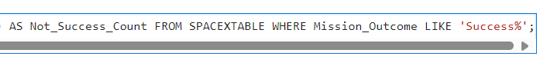
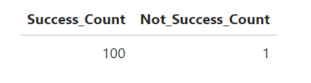
Total Number of Successful and Failure Mission Outcomes
The total number of successful and failure mission outcomes were obtained using two queries. The first get the distinct Mission_Outcome from the table, and the second count the numbers of success and unsucess using the COUNT() function and LIKE keyword.

Slide 39
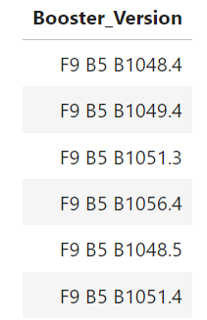
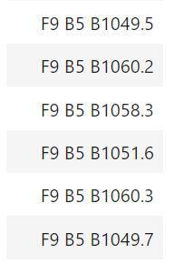
Boosters Carried Maximum Payload
The names of the booster which have carried the maximum payload mass were obtained using a nested SELECT query and WHERE keyword.
Present your query result with a short explanation here

Slide 40
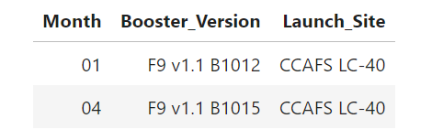
2015 Launch Records
The failed landing outcomes in drone ship for in year 2015 were obtained using a SELECT query plus a SUBSTR() / AS function
Present your query result with a short explanation here

Slide 41
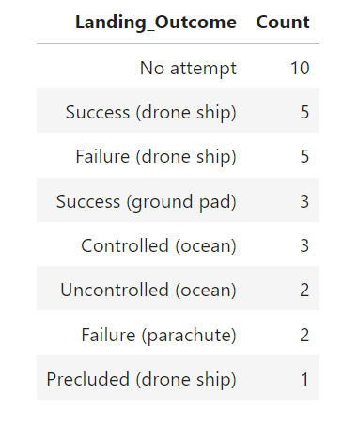
Rank Landing Outcomes Between 2010-06-04 and 2017-03-20
The rank of landing outcomes between 2010-06-04 and 2017-03-20, in descending order, was obtained using a SELECT query plus COUNT() function and plus WHERE/BETWEEN/AND keywords.

Slide 42

Section 3

Slide 43
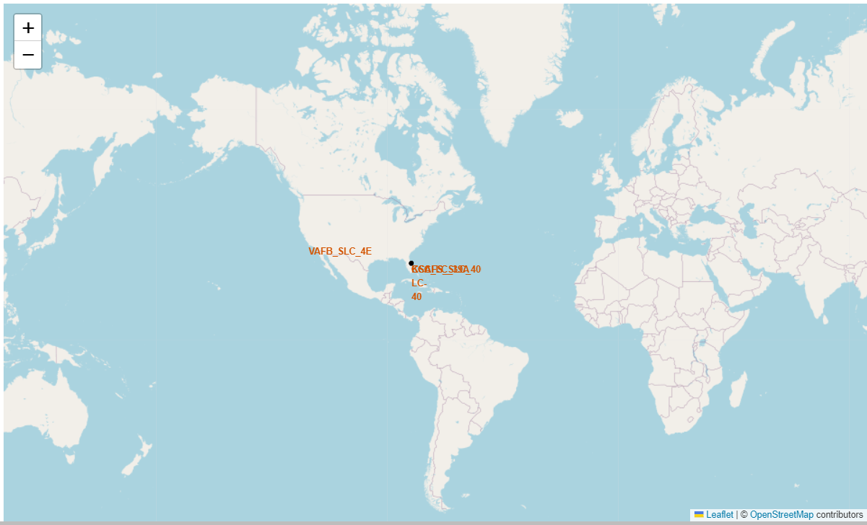
Global map showing the position of launch sites
As can be seen on the map, the launch sites are close to the Equator line.

Slide 44
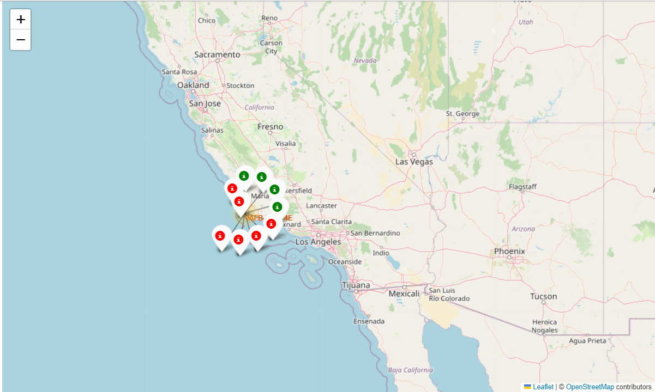
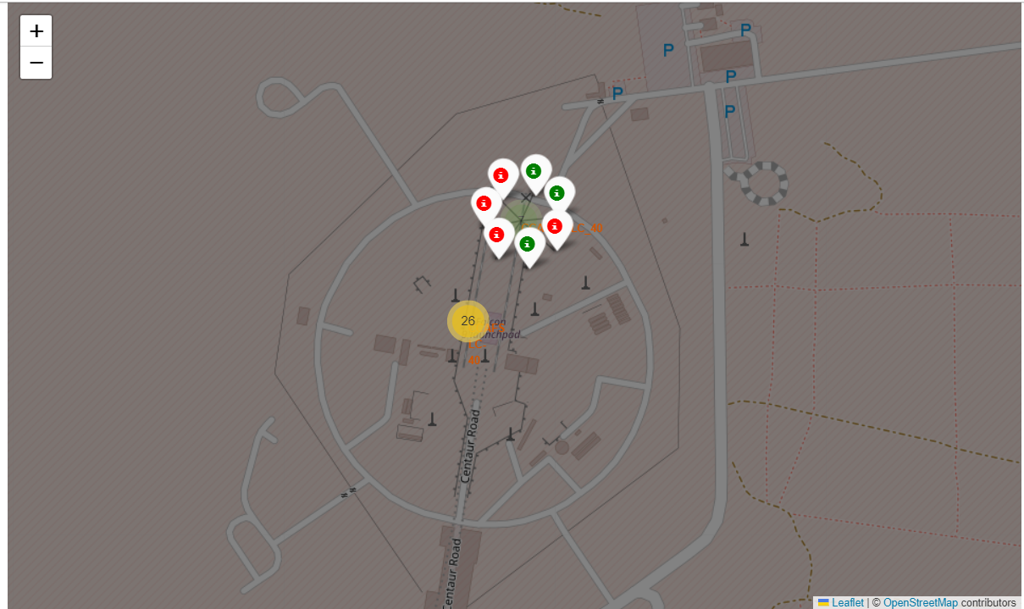
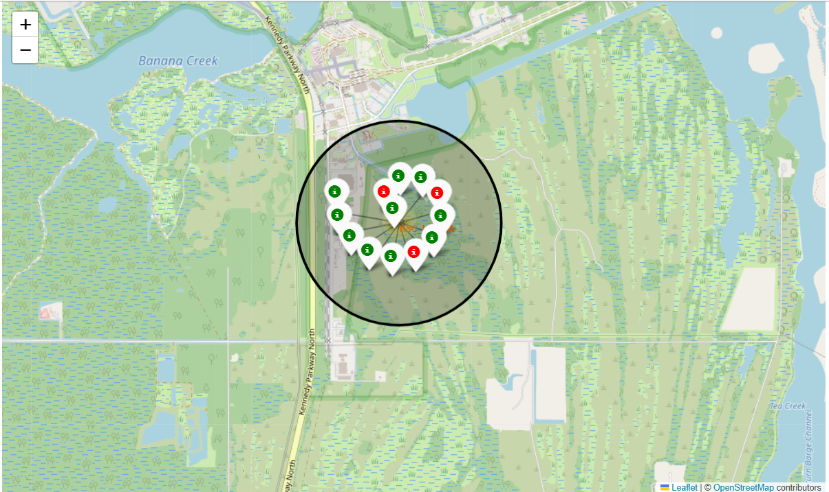
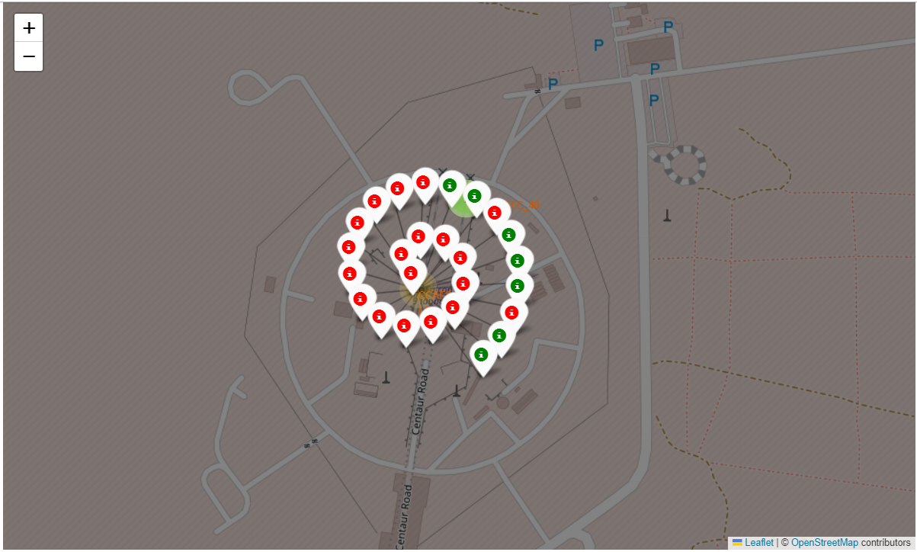
Launch outcomes on the map

Slide 45
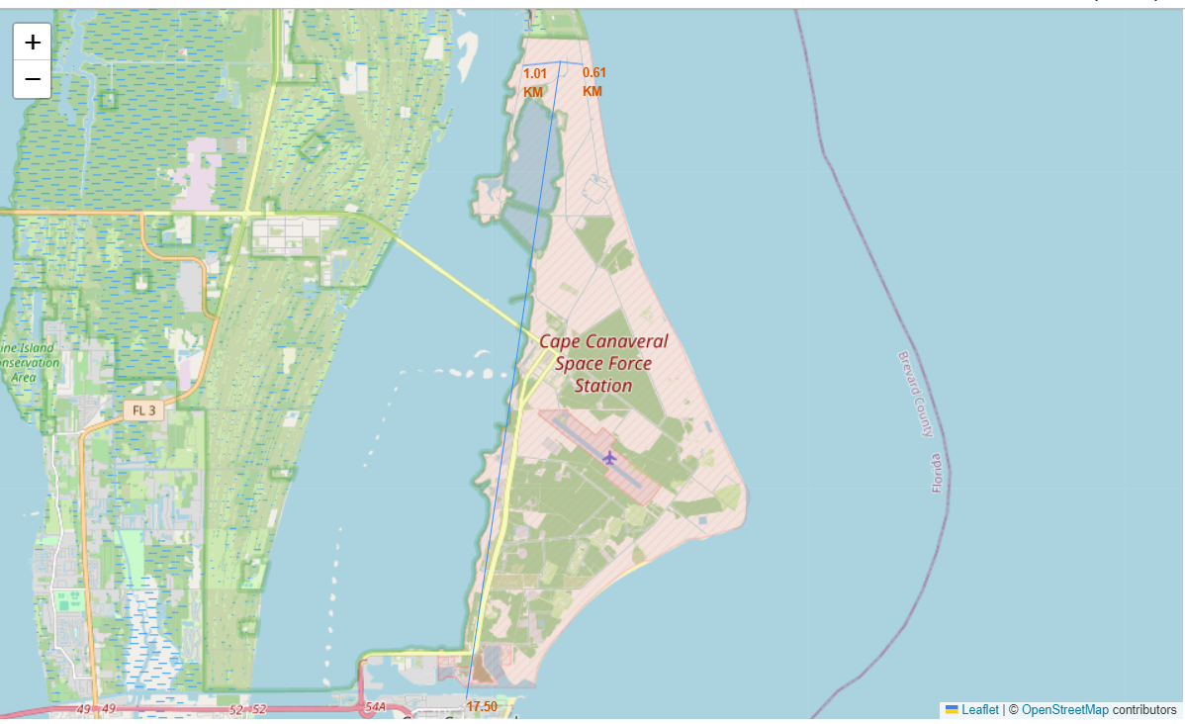
Distances to the neighborhood of the CCAFS LC-40 Launch Site
Distance to closest city (Cape Canaveral): 17,5 km
Distance to closest railway: 0,61 km
Distance to closest highway: 1,01 km

Slide 46

Section 4

Slide 47
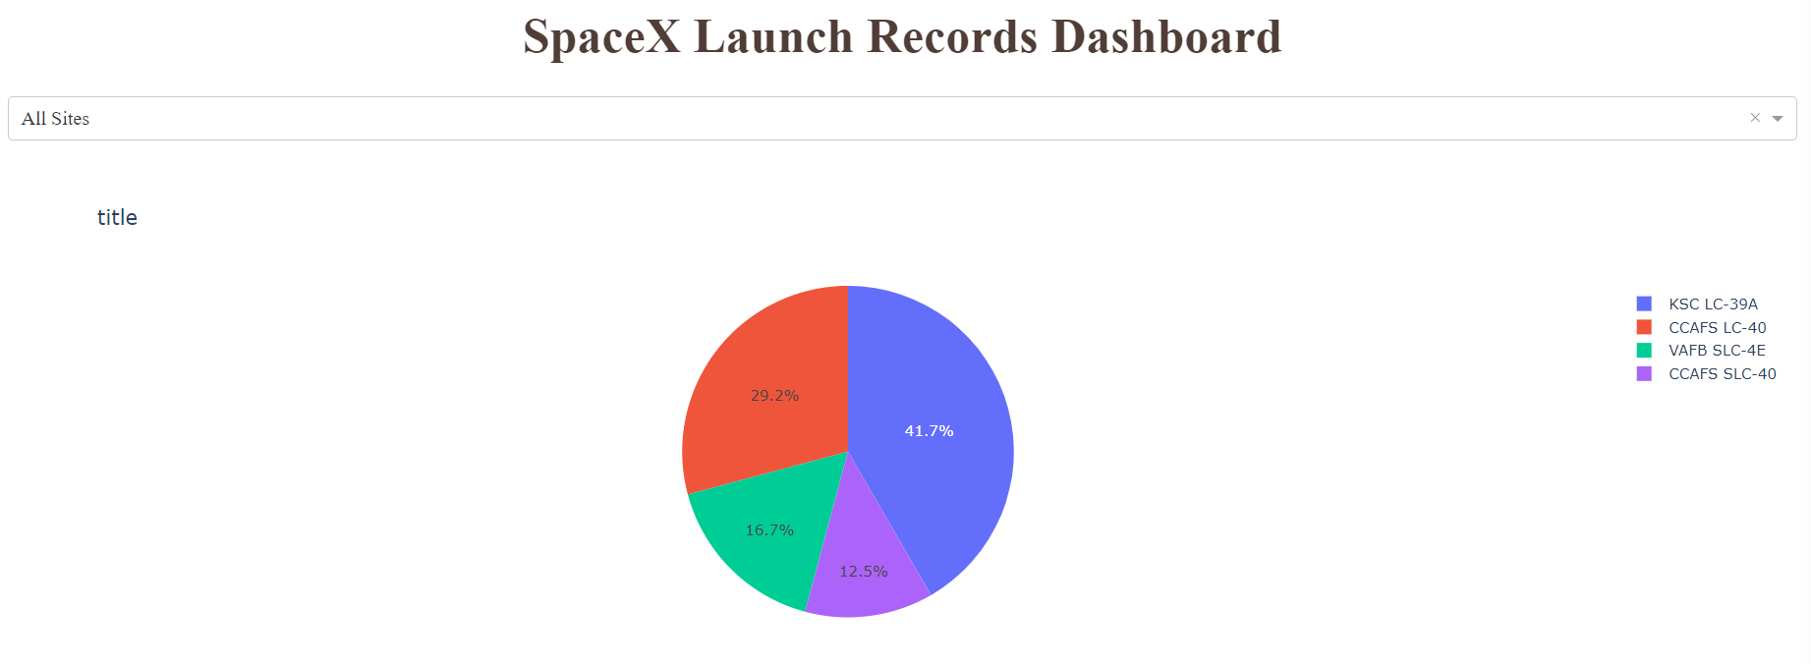
Success Count
The piechart shows four different launch sites.
KSC LC-39A has the largest success count.
CCAFS SLC-40 has the lowest success count.

Slide 48
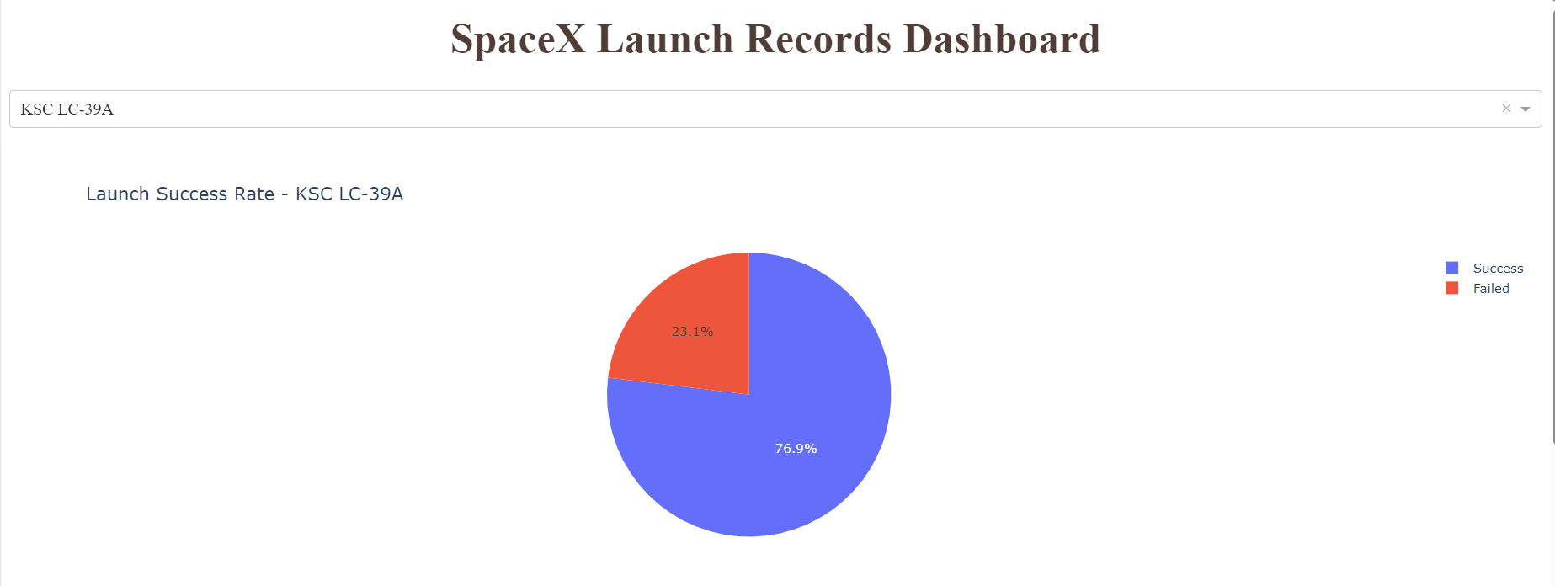
Success and failure for KSC LC-39A
The piechart shows the success and failed for KSC LC-39A site.
This site has achieved a successful rate of 76.9%.

Slide 49
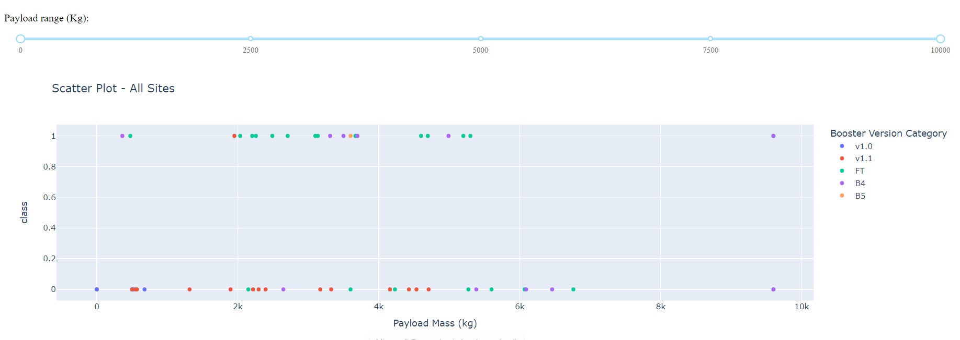
Payload vs. Launch Outcome
The scatter plot shows Payload vs. Launch Outcome for all sites, with payload selected in the range slider
Although it is not a guarantee of success, most launches that have resulted in success are in the payload mass range between 2000 and 4000 kg.
FT booster version have the largest success rate
v1.1 was only successful, although it launched across a wide range of payload masses.

Slide 50

Section 5

Slide 51
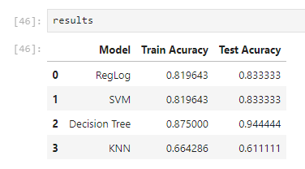
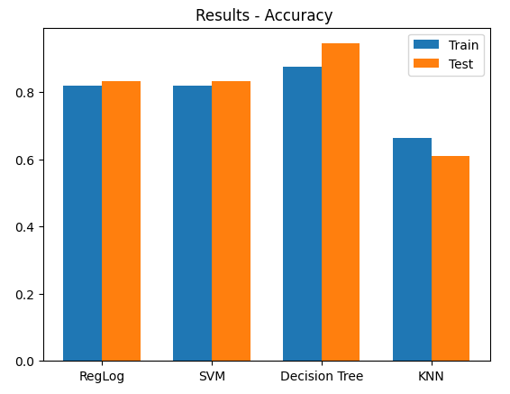
Classification Accuracy
Accuracy for all built classification models, in a bar chart
The Decision Tree model presented the highest accuracy and was considered the best model.
Link:
https://github.com/fabiorodrigocs/IBMCapstone/blob/8e13fa89cc9baa3a954b574fac4906e1c4684ef4/W4%20-%20SpaceX_Machine_Learning_Prediction_Part_5.jupyterlite%20B.ipynb

Slide 52
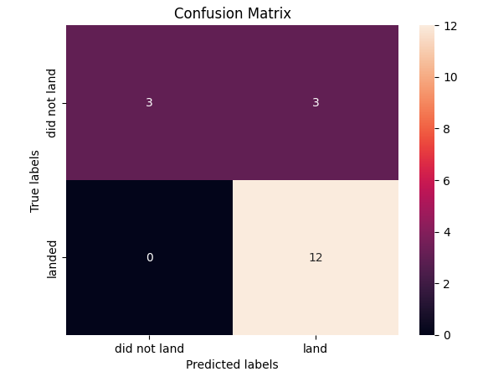
Confusion Matrix
As can be seen in the confusion matrix of the decision Logistic Regression e SVC Models, there are 03 false positives, that is, the model predicts success (land) when there was failure (did not land). Thus, the models were only able to correctly predict 50% of failure cases (did not land).
On the other hand, for all successful cases (land), the models predicted correctly, i.e., no false negatives.
Link:
https://github.com/fabiorodrigocs/IBMCapstone/blob/8e13fa89cc9baa3a954b574fac4906e1c4684ef4/W4%20-%20SpaceX_Machine_Learning_Prediction_Part_5.jupyterlite%20B.ipynb

Slide 53
Confusion Matrix
As can be seen in the confusion matrix of the Decision Tree model, there is 01 false positives, that is, the model predicts success (land) when there was failure (did not land). Thus, the model was able to correctly predict 83% of failure cases (did not land).
On the other hand, for all successful cases (land), the model predicted correctly, i.e., no false negatives.
Link:
https://github.com/fabiorodrigocs/IBMCapstone/blob/8e13fa89cc9baa3a954b574fac4906e1c4684ef4/W4%20-%20SpaceX_Machine_Learning_Prediction_Part_5.jupyterlite%20B.ipynb

Slide 54
Conclusions
Except the KNN model, all models obtained good results in terms of accuracy.
The Decision Tree Model predict correctly all successes launches and 83% of failures and achieved 94% of accuracy on test data.
The number of launches increases, the number of successes increases.
The annual success rate clearly increases over the years, reflecting a learning curve in launches.
A higher payload mass indicates that the chance of success is greater.
a high success rate was achieved for the ES-L1, GEO, HEO and SSO orbits.
There is a tendency for failure in the first launches of each orbit.
The launch sites are close to the Equator line.
KSC LC-39A has the largest success count. This site has achieved a successful rate of 76.9%.
FT booster version have the largest success rate.
Link:
https://github.com/fabiorodrigocs/IBMCapstone/blob/8e13fa89cc9baa3a954b574fac4906e1c4684ef4/W4%20-%20SpaceX_Machine_Learning_Prediction_Part_5.jupyterlite%20B.ipynb

Slide 55


